Slide 1
OS’26-27 Project
PART I: PREREQUISITES

Slide 2
Agenda
PART 0: ROADMAP
PART I: PREREQUISITES
PART II: GROUP MODULES
PART III: INDIVIDUAL MODULES
PART IV: OVERALL TESTING & BONUSES

Slide 3
Agenda
PART I: PREREQUISITES
  Pointers
  Lists
  System Calls
  Spin Locks
  Multi-CPUs & Big Kernel Lock

Slide 4

Pointers
PART I: PREREQUISITES

Slide 5
Memory and Pointers
Why we need pointers?! Pointers vs. Variables... Definition Data type & size Setting values Incrementing… Structure and accessing its members

Slide 6
Pointer vs Variables:
Definition
Pointers
Variables
  char *ptr;
  char x;

Slide 7
Pointer vs Variables:
Data type & Size
Pointers
Variables
  char *ptr;
Data type:
Data type to point into it
Size of ptr (address):
4 Byte
Size of address bus of CPU (protected → 32-bit)
  char x;
Data type:
Data type of variable itself
Size of x:
1 Byte → sizeof(char)

Slide 8
Pointer vs Variables:
Assigning value
Pointers
Variables
Assigning value:
char *c_ptr = 0x100;
//changes the pointed address
c_ptr = 0x50;
c_ptr = &x;
//changes the value within the pointed address
*c_ptr = 'A';
Assigning value:
char x = 10;
x = 50;
x = 'A';

Slide 9
Pointer vs Variables:
Incrementing
Pointers
Variables
increment:
char *c_ptr = 0x100;
c_ptr++; // ptr=0x101
int *i_ptr = 0x100;
i_ptr++; // ptr=0x104
Increases by the size of its type
increment:
char x = 10;
x++; // x=11
int x = 10;
x++; // x=11
Increases by 1

Slide 10
Pointer vs Variables:
Structure & its members
      struct MyStruct {
      int x, y;
      char c;
      char* c_ptr;
      }
Pointers
Variables
Init. & Assign.:
Struct MyStruct *my_struct;
my_struct->x = 5;
my_struct->c = 'A';
(*my_struct).y = 10
Init. & Assign.:
Struct MyStruct my_struct;
my_struct.x = 5;
my_struct.c = 'A';

Slide 11

Pointer vs Variables:
Structure & its members
      struct MyStruct {
      int x, y;
      char c;
      char* c_ptr;
      };
Pointers
Variables
Init. & Assign.:
Struct MyStruct *my_struct;
my_struct = 100;
my_struct++;
increases by size of struct
Init. & Assign.:
Struct MyStruct my_struct;
// ptr=113

Slide 12
LISTs in FOS
PART I: PREREQUISITES

Slide 13
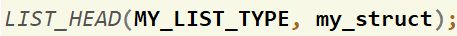
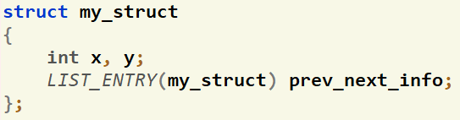
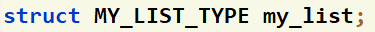
How to define LISTS in FOS?
To define a LIST that points to objects of type struct my_struct:
Create a list head that holds info about the list (size, head, tail).
  LIST_HEAD([LIST_TYPE_DEF], [STRUCT NAME THAT WILL POINTS TO]);
  Ex:
Add next and previous pointers to the struct
  LIST_ENTRY([STRUCT NAME]) prev_next_info;
  Ex:
Define your list
  struct [LIST_TYPE_DEF] my_list
  Ex:

Slide 14
How to use LISTS?
Set of helper ready made functions are available in Appendix
  LIST_INIT(…)
  LIST_INSERT_HEAD(…)
  LIST_SIZE(…)
  LIST_REMOVE(…)
  …
IMPORTANT: you should pass the list to any of these functions by reference (i.e. Put & before the name of the list)

Slide 15
System Calls
PART I: PREREQUISITES

Slide 16

System Calls – Idea
Where in Code?
lib/syscall.c
kern/trap/trap.c
kern/trap/syscall.c
inc/syscall.h
It’s OS procedure that executes privileged instructions (e.g., I/O); (API exported by kernel)
Causes a trap, which
  Switch to the kernel mode
  Look in Interrupt Descriptor Table (IDT)
  Jumps to the syscall handler in the kernel.
The syscall handler do the following:
  Save caller's state (CPU Reg’s) so it can restore control to the user process later.
  Check the system call number (Typically, a number associated with each system call)
  Call associated function that serve the given system call and pass to it the caller’s parameters
  After finish, restore caller’s state (CPU Reg’s)
  use iret instruction to return to user mode.
User Program
int main()
{
… ;
cprintf(…)
… ;
interrupt
?
ireturn
User Mode
How to pass params/return value from/to user to kernel or vice versa?
OS should verify the caller's parameters.
IDT
Kernel Mode
Read()
…
1
Syscall Handler
SYS_NO.?
Display(…)
…
2
RAM
Open(…)
…
3
CPU Reg’s
...
CPU Reg’s
Save
Caller State
Load
Print(…)
…
N

Slide 17
System Calls – Params Validation
At kernel side: need to validate any address (or range) that is passed from user to kernel to ensure that:
  NOT null pointers,
  NOT illegal pointers (e.g. pointing to kernel memory) (i.e. outside User Area)
  NOT invalid pointers (e.g. pointing to unmapped memory),
First TWO cases should be checked in the system call. If violated, kernel can terminate the user program by calling: env_exit();
Third case cause a “page fault” that can be handled in the page_fault() handler.
This technique is normally faster because it takes advantage of the processor’s MMU, so it tends to be used in real kernels (including Linux).

Slide 18
Spin Locks
PART I: PREREQUISITES

Slide 19
Locks: Definition
Locks provide two atomic operations:
  Lock.acquire() – wait until lock is free; then mark it as busy
    After this returns, we say the calling thread holds the lock
  Lock.release() – mark lock as free
    Should only be called by a thread that currently holds the lock
    After this returns, the calling thread no longer holds the lock
Negatives of interrupt-based implementation:
  Can’t give lock implementation to users
  Doesn’t work well on multiprocessor

Slide 20
Locks: Implementation
Exchange Instruction
  Exchanges the contents of a register with a memory location.
  Available in Intel IA-32 (Pentium) and IA-64 (Itanium)
  The entire function is carried out atomically;
    not subject to interruption (i.e. indivisible).
  void exchange (int register, int memory)
  {
    int temp;
    temp = memory;
    memory = register;
    register = temp;
  }

Slide 21
Locks: Implementation (SpinLock)
Simple lock that doesn’t require entry into the kernel:
// (Free) Can access this memory location from user space!
int lock = 0; // Interface: acquire(&lock);
// release(&lock);
acquire(int *thelock) {
int mykey = 1;
while (xchg(thelock, mykey)); // Atomic operation!
}
release(int *thelock) {
*thelock = 0; // Atomic operation!
}
Busy-Waiting: thread consumes cycles while waiting

Slide 22

Locks: Implementation (SpinLock)
Positives
  Machine can receive interrupts
  User code can use this lock
  Works on a multiprocessor
  No System Calls at all
Negatives
  This is very inefficient as thread will consume cycles waiting (busy-waiting)
  Cache coherence issue in multi-cores
    always read-write while waiting ➔ high traffic on cache buses to ensure data consistency
  Priority Inversion: If busy-waiting thread has higher priority than thread holding lock ⇒ no progress!
    Solution: disable the interrupt in acquire and enable it in release
Usually used for
short-time critical section

Slide 23
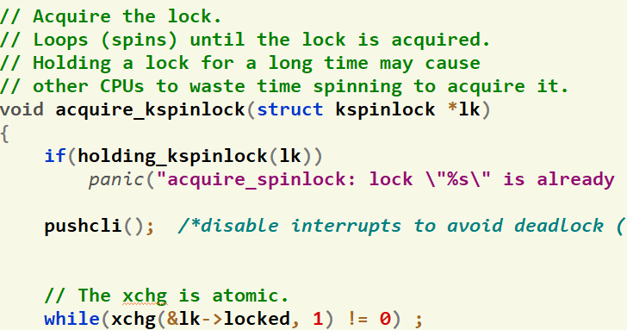
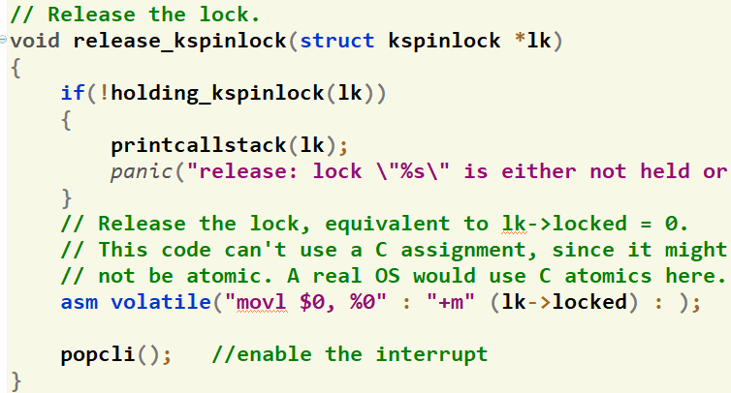
SpinLock: In Code (KERNEL)
kern/conc/kspinlock.h
kern/conc/kspinlock.c

Slide 24
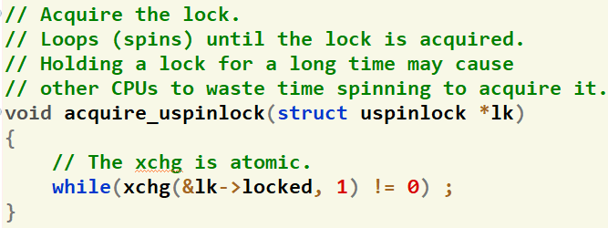
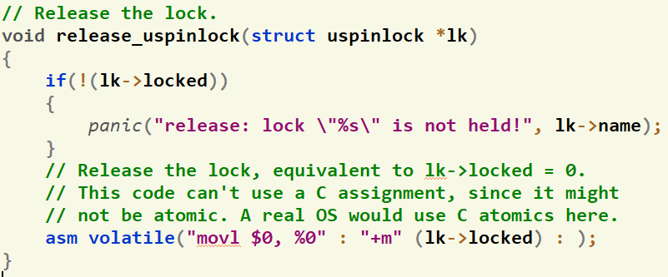
SpinLock: In Code (USER)
inc/uspinlock.h
lib/uspinlock.c
NO INTERRUPT ACCESS @USER SIDE

Slide 25
Multi-CPUs & Big Kern Lock
PART I: PREREQUISITES

Slide 26
Multi-CPUs
FOS supports multi-processors platform (up-to 8 CPUs) [can be changed in .bochsrc file]
The actual number is specified in NCPUS defined in inc/mmu.h
Each CPU has a set of info defined in struct CpuInfo in kern/cpu/cpu.h including
  Unique ID
  Kernel stack to run the scheduler
  Current running environment (if any)
cpus[NCPUS]: is an array of all CPUs defined in kern/cpu/cpu.h
struct CpuInfo {
unsigned char cpu_id;
char* stack;
struct Env *proc;
...
};

Slide 27
Multi-CPUs – Functions
1. Get the current running CPU
struct CpuInfo* mycpu()
2. Get/Set the current running process
struct Env* get_cpu_proc(); void set_cpu_proc(struct Env* p);
3. Disable/Enable the interrupt of the current CPU
void pushcli(); void popcli();
Refer to APPENDIX VI for more helper functions...

Slide 28


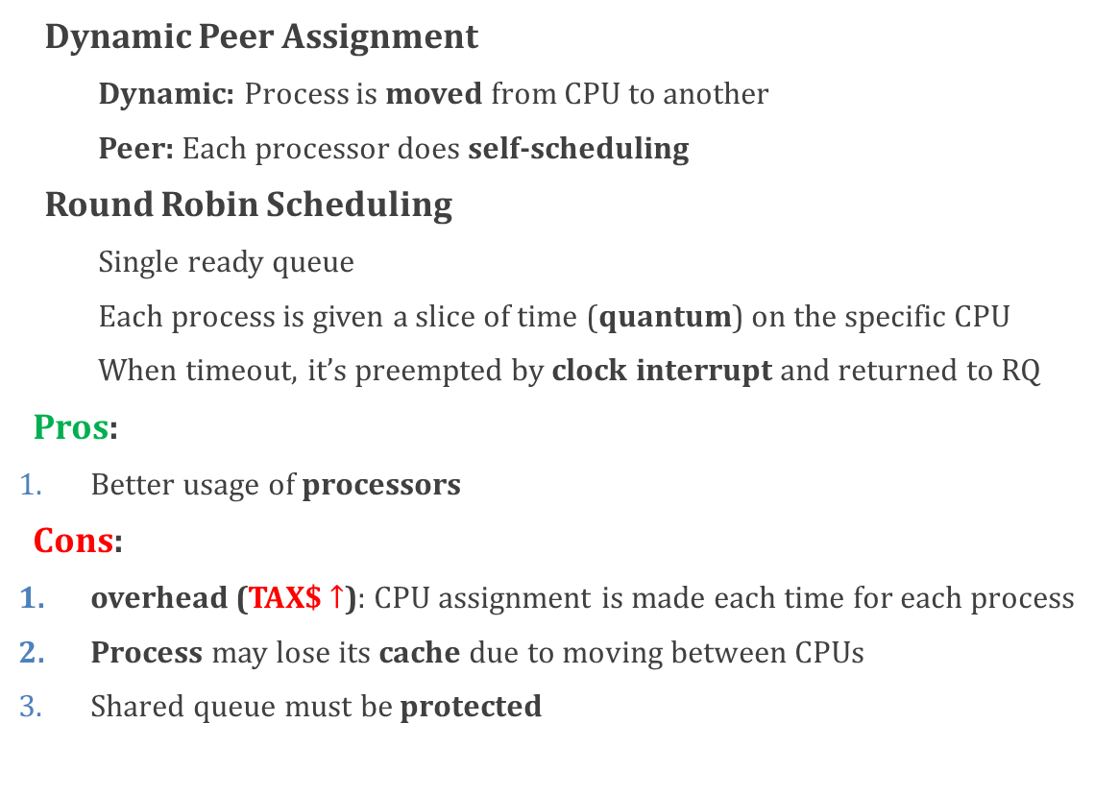
Multi-CPUs – Scheduling
Dynamic Peer Assignment
Dynamic: Process is moved from CPU to another
Peer: Each processor does self-scheduling
Round Robin Scheduling
Single ready queue
Each process is given a slice of time (quantum) on the specific CPU
When timeout, it’s preempted by clock interrupt and returned to RQ
Pros:
Better usage of processors
Cons:
overhead (TAX$ $↑$): CPU assignment is made each time for each process
Process may lose its cache due to moving between CPUs
Shared queue must be protected
CPU₁
P_{m}
…
P₂
P₁
CPU₂
.
.
.
CPU_{n}

Slide 29


Multi-CPUs – Big Kern Lock
Problem: concurrency bugs (non-determinism) when multiple CPUs run kernel code simultaneously.
Solution: use a “big kernel lock”
Single global lock that is held whenever an environment enters kernel mode
Released when the environment returns to user mode.
Environments in user mode can run concurrently on any available CPUs,
But no more than one environment can run in kernel mode
Proc A
Proc B
Proc D
Proc C
Kernel
Proc C
Proc B
Proc A
Proc A
Proc A
Proc B
Proc B

Slide 30
Multi-CPUs – Big Kern Lock
Entrance:
Via mp_main(): booting of each CPU
Via trap(): System call, Exception or Interrupt
Exit:
Via trap(): return to same process or another process
Via sched_halt(): no process to schedule! CPU is halted until next clock interrupt
Via env_start(): new process is just started.
Rule:
Acquire lock before entrance
Release lock before exit
Proc A
Proc B
Proc C
lock_kernel()
Kernel
trap()
mp_main()
unlock_kernel()
trap()
Sched_halt()
env_start()

Slide 31

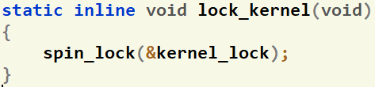
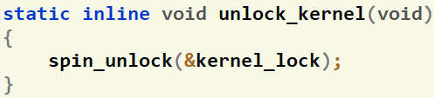
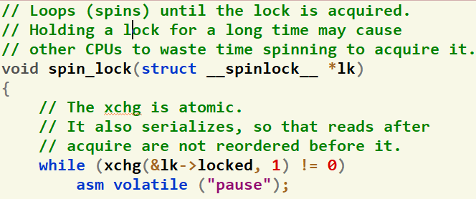
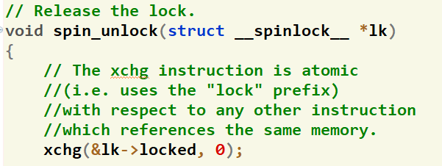
Multi-CPUs – Big Kern Lock
kern/conc/bigkernellock.h
kern/conc/bigkernellock.c

Slide 32

NOW, LET’S START CODING TOGETHER...
☺ Enjoy developing your own OS ☺

